Slide 1
Preventing Stressful Situations with Emotional Resilience
Jordania Leon-Jordan
Interim CIO
UW-Parkside

Slide 2
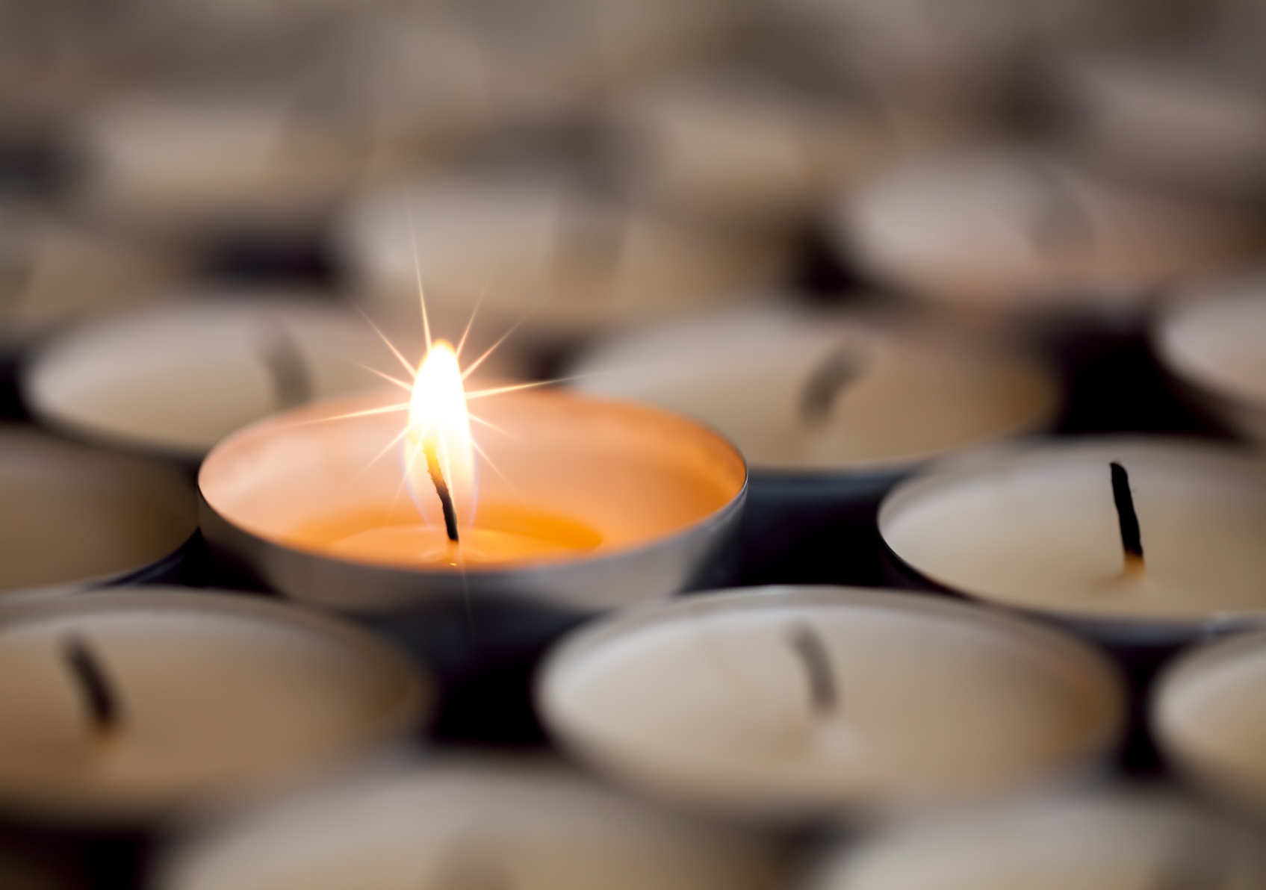
Emotional Resilience
Notes:
The skill to adjust to change and move on, in a positive way.
A person with high resilience knows how to prevent and bounce back from situation where you may experience anger, frustration, stress and anxiety.
It is not about ignoring emotions or pushing them down, but about acknowledging and managing these emotions.
Be calm and clear headed when pressure and stress around you are high
Don’t get stuck in resentment, anger and bitterness
Keep a sense of humor
Keep things in perspective
Do not take things personally

Slide 3
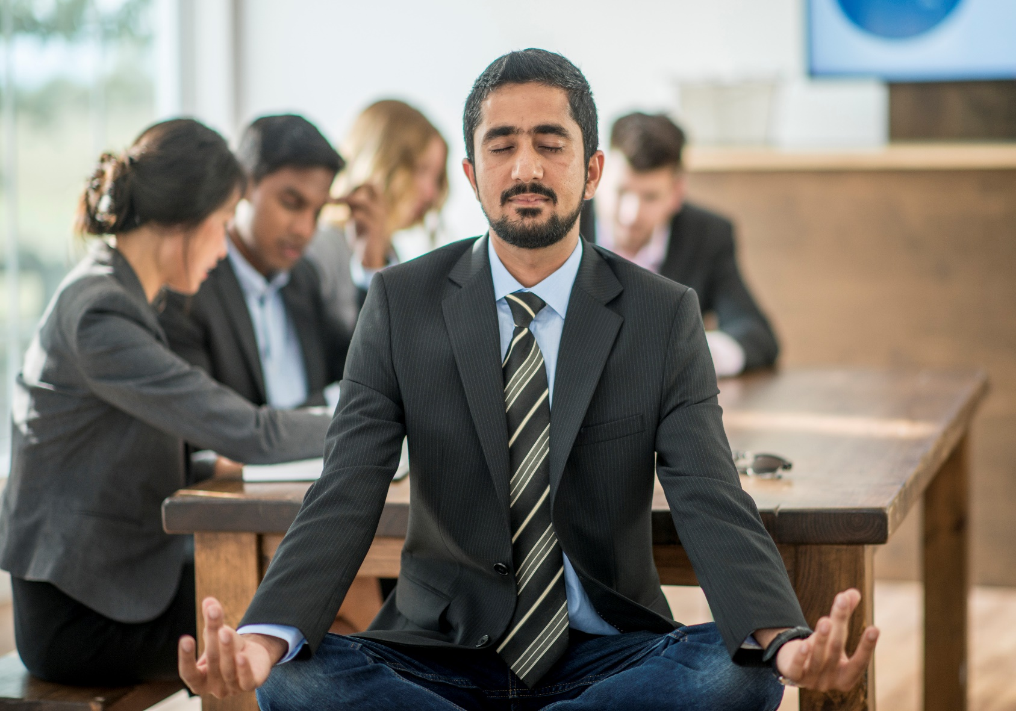
1. Pillar: Stay Calm, Cool and Collected

Slide 4
Stay calm, cool, and collected
Keep calm and cool with annoying co-workers
Don’t take things personally
Handle a high workload without being overwhelmed
Notes:
Keep Calm…
Be realistic
Enquiry
Predict and have fun
Change your reaction
Talk to people in advance
Don’t take things personally
Laugh
Delay your response
Don’t take it personally
Monitor for early signs of irritation
Breath Deeply
Handling a high workload without being overwhelmed
Be active and healthy
Be positive
Sort demands into areas
Do the priorities
Change priorities at any moment

Slide 5

2. Pillar: Control Your Emotions

Slide 6
Control Your Emotions
Be mindful during conflict
Self-calm your anger
Managing you anxiety
Notes:
Be mindful during conflict
Stay present
Stop the judging mind
Focus on your body: Body scan meditation
Breath
Self-calm your anger
Kindness and generosity
Laugh
Write down the anger
Know why you are angry
Managing you anxiety
Catch it early
Accept it
Observe it
Focus on something else
Meditate

Slide 7

3. Pillar: Create Positive Emotions Daily

Slide 8
Create Positive Emotions Daily
Stop Negativity
List 10 good things about your work
Make your workplace nicer
Praise yourself
Take a break
Have a bank account of positive emotions
Notes:
Stop negativity
List 10 good things about your work
Manage your workplace nicer
Praise yourself
Take a break
Have a bank account of positive emotions

Slide 9

4. Pillar: Develop Self-Compassion

Slide 10
Develop Self Compassion
Have a success journal
Reward yourself
Spread the love
Set aside time for yourself
Ask for help
Notes:
Have a success journal
Reward yourself
Spread the love
Set aside time for yourself
Ask for help

Slide 11

5. Pillar: Be Grateful and Forgive

Slide 12
Be Grateful
Be Grateful
Feel grateful
Be grateful for what you have
Be grateful for help
Be grateful that you are better off than others

Slide 13
Forgive
Forgive
Do not push yourself to forgive others immediately
Stop wearing the mask
Move on with your life
Separate the person from the behavior
Protect yourself and your dignity

Slide 14
Questions?

Slide 15
Thank You!

